Slide 1


Slide 2
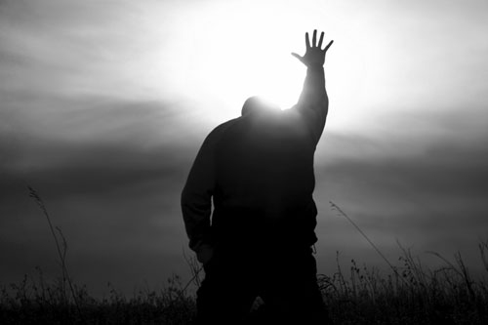
“ALL THIS GLORY” Crowder/Giglio ccli6223560
In the middle of the mess,
There is majesty
In the middle of my chest,
Is the King of Kings
While the world was waiting on,
A change to come along
Light broke in, Coming like a song

Slide 3
All this glory, All this glory, All this glory
In the middle of the night, All this light
In the middle of the night,
All this light here

Slide 4
In the middle of the night,
You are Majesty
To the middle of our plight,
Came the King of Kings
While we were waiting on,
Your love to come along
Light broke in, Coming like a Son.

Slide 5
All this glory, All this glory,
All this glory, All this glory
In the middle of the night, All this light
In the middle of the night, All this light
In the middle of the night, All this light
In the middle of the night,
After all this quiet

Slide 6
Jesus, God with us,
Jesus Christ has come,
And I'm undone
Jesus, God with us,
Jesus Christ has come,
And I’m undone

Slide 7
All this glory, All this glory,
All this glory, All this glory
Jesus, God with us,
Jesus Christ has come,
And I'm undone
Jesus, God with us,
Jesus Christ has come,
And love has won

