Slide 1


Slide 2
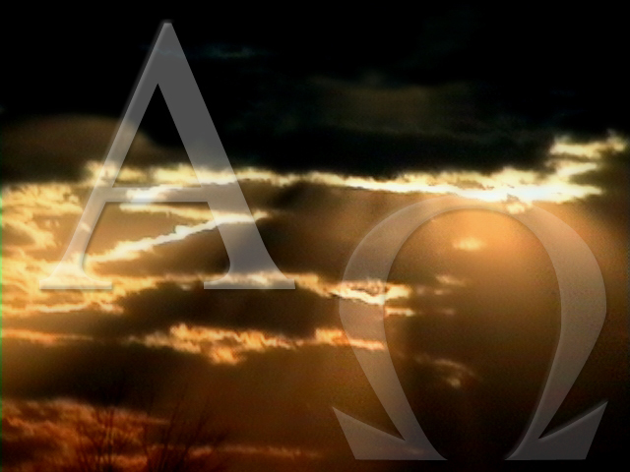
ALPHA and OMEGA
I heard a great voice
Out of Heaven saying
Behold the tabernacle
of God is with men
He shall dwell within them
They shall be His people
And all mighty God will be with them

Slide 3
He shall wipe away all fears
From their eyes
There shall be no more death
Neither sorrow nor crying
And no more pain
The former things are all passed away.

Slide 4
He that sat upon the throne
Said “Behold,
I make all things new”
He said unto me
“Write these words
For they are faithful and true”
And it is done, It is done
It is done, It is done

Slide 5
He is the Alpha and Omega
The Beginning and the End
The Son of God, King of Kings
Lord of Lords, He’s everything
Messiah, Jehovah
The Prince of Peace is He
The Son of Man, Seed of Abraham
Second Person of the Trinity

