Slide 2
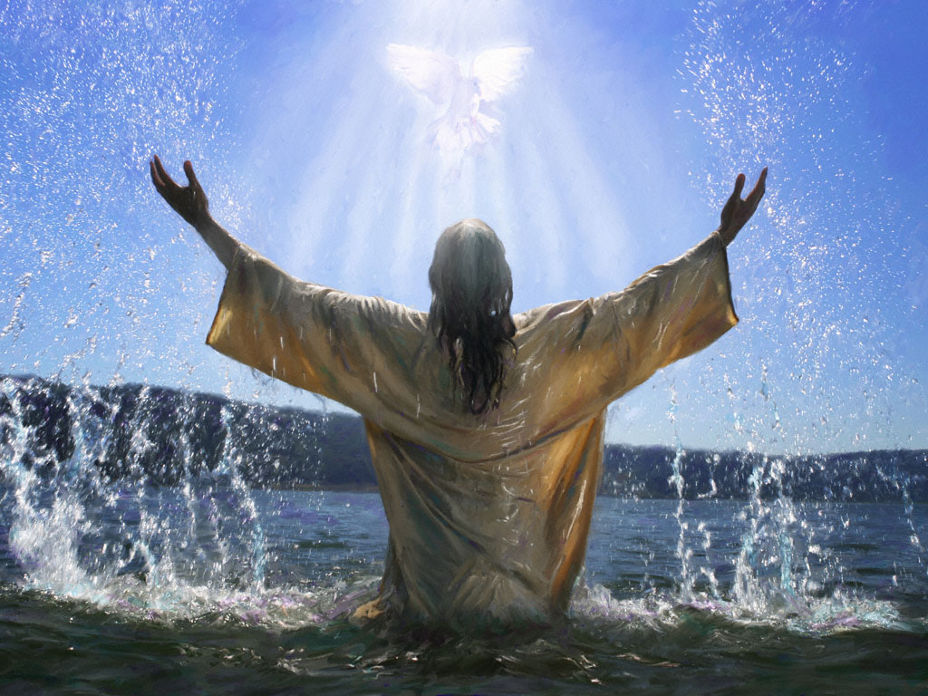
“ARISE” Paul Baloche ccli 4032337
One thing we ask of You,
One thing that we desire
That as we worship You,
Lord come and change our lives
Arise, Arise, Arise, Arise

Slide 3
Arise take Your place
Be enthroned on our praise
Arise King of kings
Holy God as we sing
Arise, Arise, Arise, Arise

Slide 4
One thing we ask of You,
One thing that we desire
That as we worship You,
Lord come and change our lives
Arise, Arise, Arise, Arise

Slide 5
Arise take Your place
Be enthroned on our praise
Arise King of kings
Holy God as we sing
Arise, Arise, Arise, Arise

Slide 6
We lift You up, We lift You up,
We lift You up on our praises
We lift You up, We lift You up,
We lift You up on our praises

Slide 7
Arise take Your place
Be enthroned on our praise
Arise King of kings
Holy God as we sing
Arise, Arise, Arise, Arise

