Slide 1


Slide 2
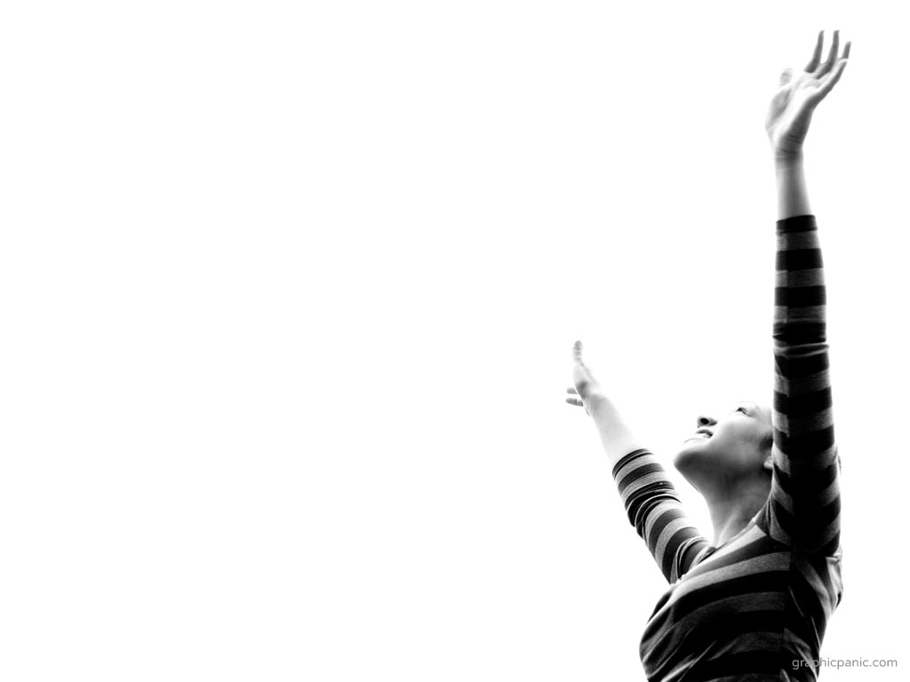
“BEAUTIFUL ONE” Tim Hughes ccli 3915912
Wonderful so wonderful
Is Your unfailing love
Your cross has spoken mercy over me
No eye has seen
No ear has heard
No heart could fully know
How glorious
How beautiful You are

Slide 3
Beautiful One I love
Beautiful One I adore
Beautiful One
My soul must sing

Slide 4
Powerful so powerful
Your glory fills the skies
Your mighty works
Displayed for all to see
The beauty of Your majesty
Awakes my heart to sing
How marvelous
How wonderful You are.

Slide 5
Beautiful One I love
Beautiful One I adore
Beautiful One
My soul must sing

Slide 6
You opened my eyes
To Your wonders anew
You captured my heart
With this love
'Cause nothing on earth
Is as beautiful as You. (x2)

Slide 7
Beautiful One I love
Beautiful One I adore
Beautiful One
My soul must sing

