Slide 2
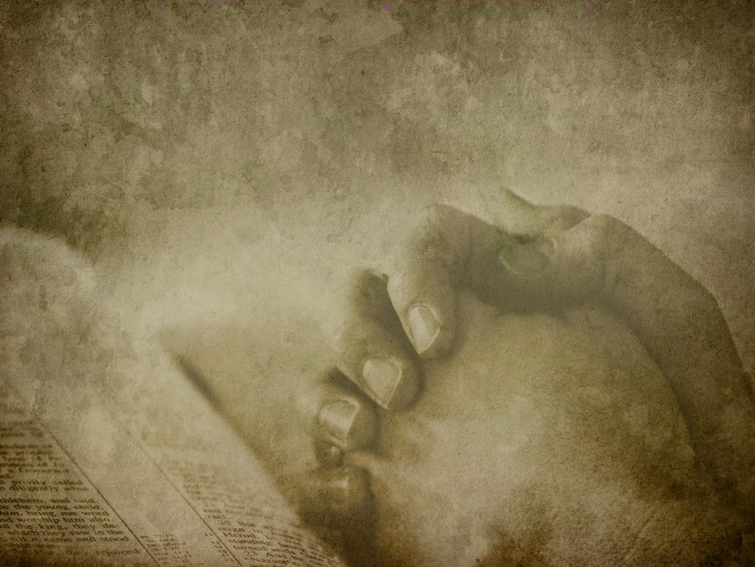
Because He Lives
God sent His son they called Him Jesus
He came to love, heal and forgive
He bled and died to buy my pardon
An empty grave is there
to prove my Savior lives

Slide 3
Because He lives I can face tomorrow
Because He lives all fear is gone
Because I know He holds the future
And live is worth the living
Just because He lives.

Slide 4
How sweet to hold our newborn baby
And feel the pride and joy He gives
But greater still the calm assurance
This child can face uncertain days
Because Christ lives.

Slide 5
Because He lives I can face tomorrow
Because He lives all fear is gone
Because I know He holds the future
And live is worth the living
Just because He lives.

Slide 6
And then one day I’ll cross that river
I’ll fight life’s final war with pain
And then as death gives way to vict’ry
I’ll see the lights of glory
And I’ll know He reigns

Slide 7
Because He lives I can face tomorrow
Because He lives all fear is gone
Because I know He holds the future
And life is worth the living
Just because He lives.

