Slide 2
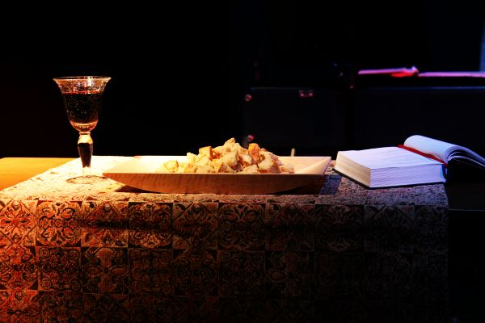
Communion
Powell, Avery, Carr, Anderson, Lee ccli
This is the body, This is the blood
Broken and poured out, For all of us
And In this communion,
We share in His love
This is the body, This is the blood

Slide 3
I will remember ev'rything Lord,
That You've done for me
I won't take for granted the sacrifice,
That set me free
I hunger and thirst for Your love,
Come fill me today

Slide 4
This is the body, This is the blood
Broken and poured out, For all of us
And In this communion,
We share in His love
This is the body, This is the blood

Slide 5
We hunger and thirst for Your love
And Your righteousness.
We long for Your presence here Lord
Be with us again.

Slide 6
This is the body, This is the blood
Broken and poured out, For all of us
And In this communion,
We share in His love
This is the body, This is the blood

