Slide 1


Slide 2
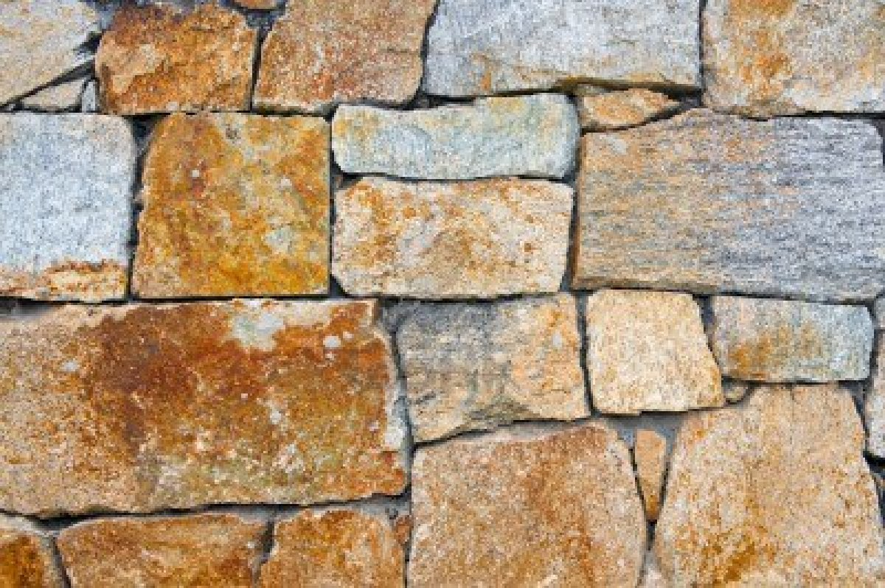
Cornerstone ccli: 6158927
My hope is built on nothing less
Than Jesus’ blood and righteousness
I dare not trust the sweetest frame but wholly trust in Jesus’ Name
(2x)

Slide 3
Christ alone
Cornerstone
Weak made strong
In the Saviour’s love
Through the storm
He is Lord
Lord of all

Slide 4
When darkness seems to hide His face
I rest on His unchanging grace
In ev’ry high and stormy gale
My anchor holds within the veil
My anchor holds within the veil

Slide 5
Christ alone
Cornerstone
Weak made strong
In the Saviour’s love
Through the storm
He is Lord, Lord of all
He is Lord, Lord of all

Slide 6
When He shall come with trumpet sound
Oh may I then in Him be found
Dressed in His righteousness alone
Faultless stand before the throne
Faultless stand before the throne

Slide 7
Christ alone
Cornerstone
Weak made strong
In the Saviour’s love
Through the storm
He is Lord, Lord of all
He is Lord, Lord of all

Slide 8
Christ alone
Cornerstone
Weak made strong
In the Saviour’s love
Through the storm
He is Lord, Lord of all

