Slide 2
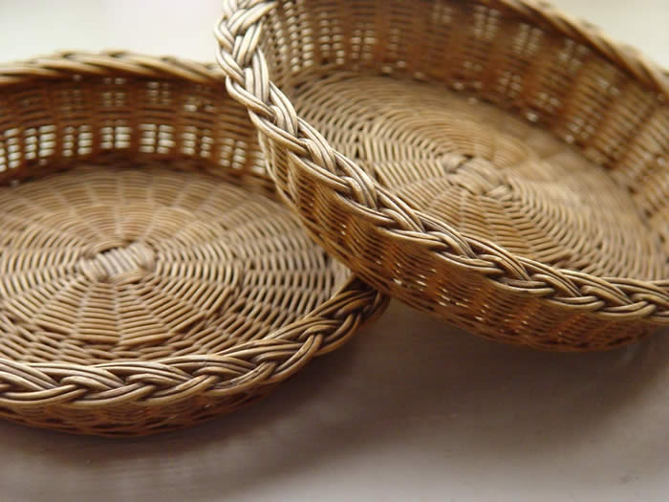
“FATHER I ADORE YOU” Terrye Coelho ccli 26557
Father I adore You, Lay my life before You,
How I love You
Jesus I adore You, Lay my life before You,
How I love You
Spirit I adore You, Lay my life before You,
How I love You

