Slide 2
Great is the Lord Michael W Smith ccli 1149
Great is the Lord, He is holy and just
By His power we trust in His love
Great is the Lord, He is faithful and true
By His mercy He proves He is love

Slide 3
Great is the Lord Michael W Smith ccli 1149
Great is the Lord and worthy of glory
Great is the Lord and worthy of praise
Great is the Lord, now lift up your voice
Now lift up your voice: Great is the Lord

Slide 4
Great is the Lord Michael W Smith ccli 1149
Great is the Lord, He is holy and just
By His power we trust in His love
Great is the Lord, He is faithful and true
By His mercy He proves He is love

Slide 5
Great is the Lord Michael W Smith ccli 1149
Great are You, Lord and worthy of glory
Great are You, Lord and worthy of praise
Great are You, Lord, I lift up my voice
I lift up my voice: Great are You Lord
Great are You Lord (3x)

Slide 6
LORD COME TO ME
Joe Goldsmith
Lord, come to me, I need your grace Lord, come to me, Show me the way Into your arms, Keep me safe Please take my hand,
Cuz all I can do is pray

Slide 7
Lord, be with me, Help me find the words Lord, be with me, Show me the truth
Help me understand, What this all means Open my eyes, I’m callin out to You

Slide 8
Lord take me, Take me all away
Make me born again,
In the light of Your grace Lord take me, Place me in your heart Fill my life with love,
With You I want to start

Slide 9
Lord, I sing to You, I lift up my hands Lord, I sing to You, I proudly stand
I’m not ashamed, To spread Your word To everyone I say,
“There’s glory in His name!”

Slide 10
Lord take me, Take me all away
Make me born again,
In the light of Your grace Lord take me, Place me in your heart Fill my life with love,
With You I want to start

Slide 11
You are the way
You are the truth You are the light
I’ve been renewed

Slide 12
Lord take me, Take me all away
And make me born again,
In the light of Your grace Lord take me, Place me in your heart Fill my life with love,
With You I want to start

Slide 14
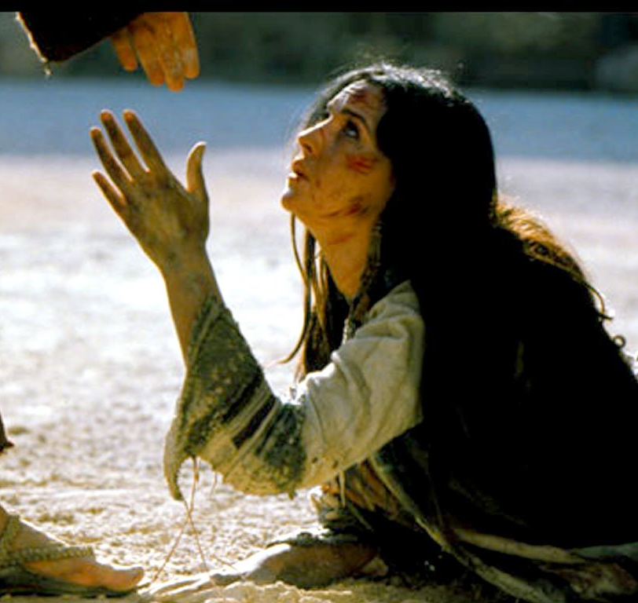
WE FALL DOWN Chris Tomlin
We fall down, we lay our crowns
At the feet of Jesus;
The greatness of His mercy and love,
At the feet of Jesus.
And we cry holy, holy, holy,
And we cry holy, holy, holy,
And we cry holy, holy, holy is the Lamb.

Slide 16
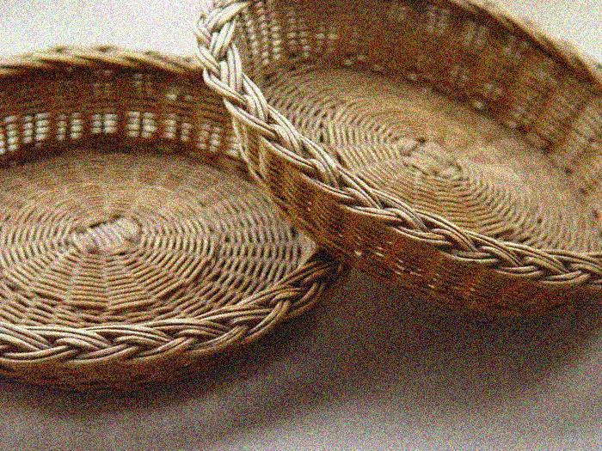
OFFERING Paul Baloche ccli 3956562
The sun cannot compare
To the glory of Your love
There is no shadow in Your presence
No mortal man would dare
To stand before Your throne
Before the Holy One of heaven
It's only by Your blood
And it's only through Your mercy
Lord I come

Slide 17
I bring an offering
Of worship to my King
No one on earth deserves
The praises that I sing
Jesus may You receive
The honor that You're due
O Lord I bring an offering to You

Slide 19
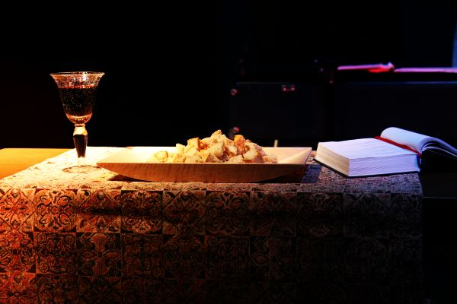
Communion
Powell, Avery, Carr, Anderson, Lee ccli
This is the body, This is the blood
Broken and poured out, For all of us
And In this communion,
We share in His love
This is the body, This is the blood

Slide 20
I will remember ev'rything Lord,
That You've done for me
I won't take for granted the sacrifice,
That set me free
I hunger and thirst for Your love,
Come fill me today

Slide 21
This is the body, This is the blood
Broken and poured out, For all of us
And In this communion,
We share in His love
This is the body, This is the blood

Slide 22
We hunger and thirst for Your love
And Your righteousness.
We long for Your presence here Lord
Be with us again.

Slide 23
This is the body, This is the blood
Broken and poured out, For all of us
And In this communion,
We share in His love
This is the body, This is the blood

Slide 25
YOUR NAME IS HOLY
Jeff Deyo ccli 4248822
You're glorious magnificent
Your name is holy holy
You're wonderful spectacular
Your name is holy holy

Slide 26
I searched the world, To find true love
And now I know Your name
I find my freedom in Your name, Jesus
I find my power in the name, Of Jesus
Your name is truth, Your name is life,
Your name is holy holy.

Slide 27
You're beautiful untouchable
Your name is holy holy
You're marvelous extravagant
Your name is holy holy

Slide 28
I searched the world, To know real joy
And now I know Your name
I find my healing in Your name, Jesus
I find my passion in the name, Of Jesus
Your name is hope, Your name is peace, Your name is holy holy.

Slide 29
Holy, holy, holy
I searched the world
To know real love,
And now I know Your Name

Slide 30
I find my healing in Your name, Jesus
I find my passion in the name, Of Jesus
Your name is hope, Your name is peace, Your name is holy holy
Your name is truth, Your name is life, Your name is holy holy
Holy holy, holy, holy.

