Slide 1


Slide 2
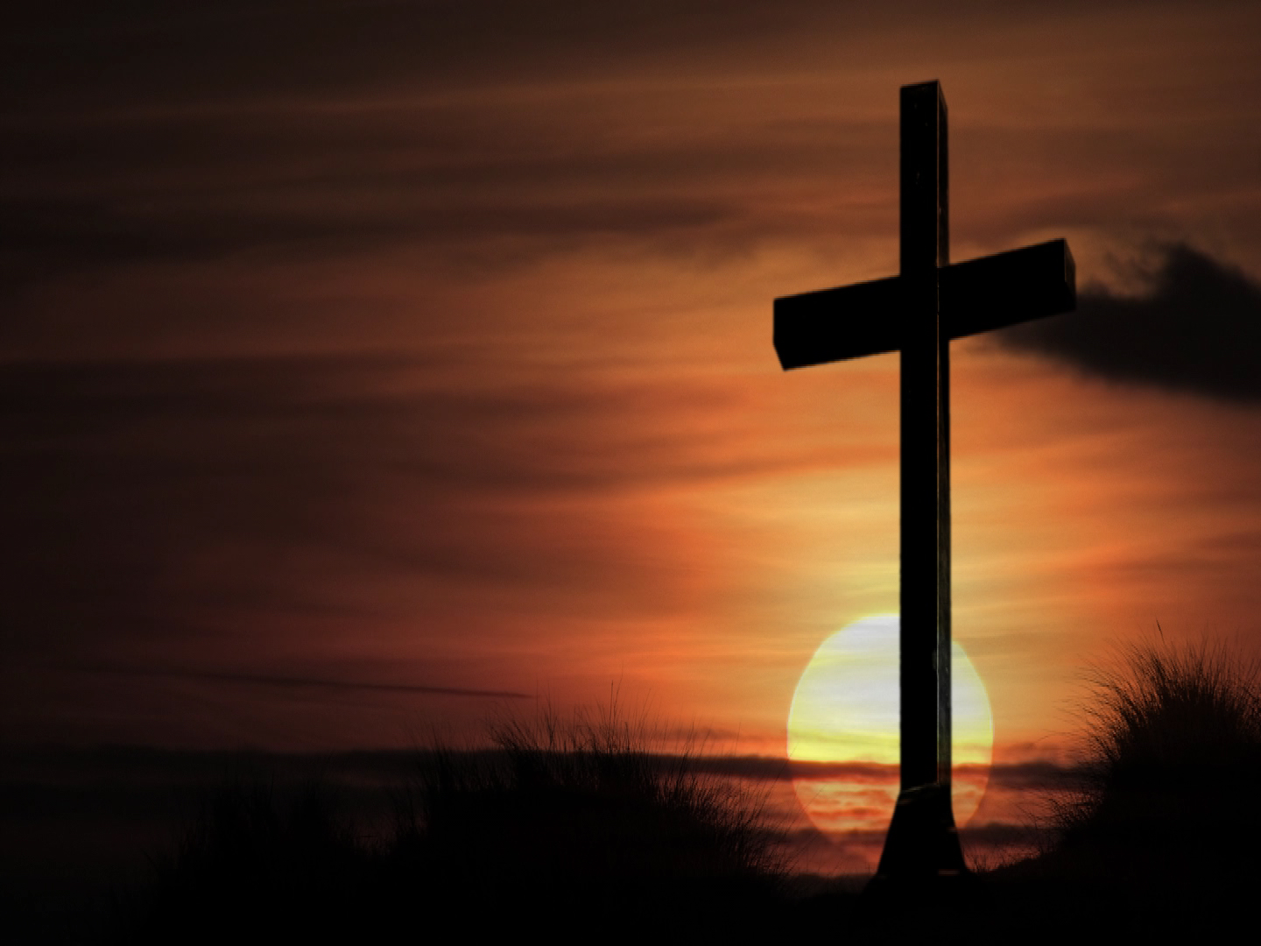
Here I Am to Worship Tim Hughes
Light of the world
You stepped down into darkness
Opened my eyes let me see
Beauty that made
This heart adore You
Hope of a life spent with You

Slide 3
So here I am to worship
Here I am to bow down
Here I am to say that
You’re my God
And You’re altogether lovely
Altogether worthy
Altogether wonderful to me

Slide 4
King of all days
Oh so highly exalted
Glorious in Heaven above
Humbly You came
To the earth You created
All of love’s sake became poor

Slide 5
So here I am to worship
Here I am to bow down
Here I am to say that
You’re my God
And You’re altogether lovely
Altogether worthy
Altogether wonderful to me

Slide 6
And I’ll never know how much it cost
To see my sin upon that cross
(2x)

Slide 7
So here I am to worship
Here I am to bow down
Here I am to say that
You’re my God
And You’re altogether lovely
Altogether worthy
Altogether wonderful to me

