Slide 2
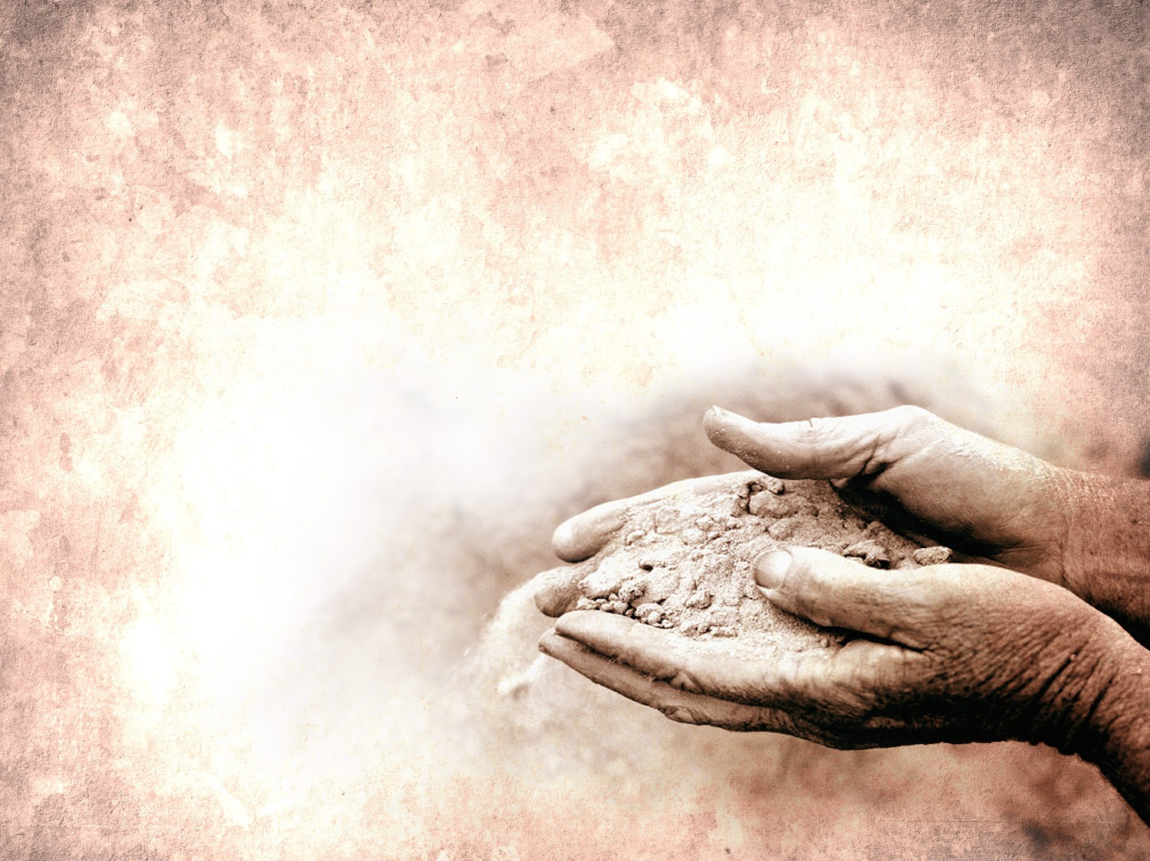
“HUNGRY” Kathryn Scott ccli 2650364
Hungry I come to You,
For I know You satisfy
I am empty, But I know Your love
Does not run dry,
So I wait for You
So I wait for You

Slide 3
I'm falling on my knees
Offering all of me
Jesus You're all
This heart is living for

Slide 4
Broken I run to You,
For Your arms are open wide
I am weary, But I know Your touch
Restores my life,
So I wait for You
So I wait for You

Slide 5
I'm falling on my knees
Offering all of me
Jesus You're all
This heart is living for

Slide 6
I’m falling on my knees
Offering all of me
Jesus, You’re all this
Heart is living for.
So I wait for You
So I wait for You

Slide 7
I’m falling on my knees
Offering all of me
Jesus, You’re all this
Heart is living for.

Slide 8
Hungry I come to You,
For I know You satisfy
I am empty,
But I know Your love
Does not run dry.

