Slide 2
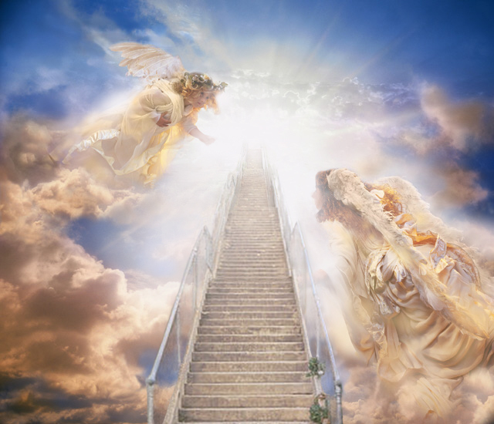
I Will Call upon the Lord Michael O’Shields
I will call upon the Lord
Who is worthy to be praised
So shall I be saved from my enemies
I will call upon the Lord

Slide 3
The Lord liveth and blessed be the Rock
And let the God of my salvation be exalted
The Lord liveth and blessed be the Rock
And let the God of my salvation be exalted

Slide 4
I will call upon the Lord
Who is worthy to be praised
So shall I be saved from my enemies
I will call upon the Lord

Slide 5
The Lord liveth and blessed be the Rock
And let the God of my salvation be exalted
The Lord liveth and blessed be the Rock
And let the God of my salvation be exalted

