Slide 1


Slide 2
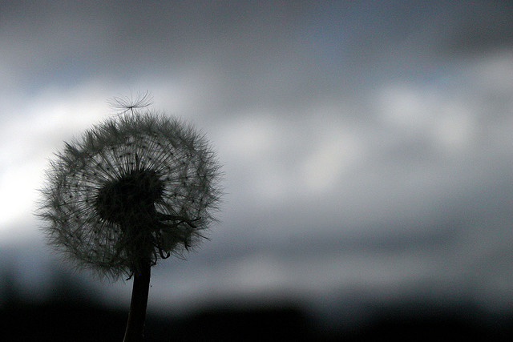
“I’ll Fly Away” Albert Brumley ccli 26399
Some glad morning when this life is o’re,
I’ll fly away.
To a land on God’s celestial shore,
I’ll fly away.
I’ll fly away, O glory; I’ll fly away.
When I die, hallelujah, by and by,
I’ll fly away.

Slide 3
When the shadows of this life have grown
I’ll fly away
Like a bird from prison bars has flown
I’ll fly away
I’ll fly away, O glory; I’ll fly away.
When I die, hallelujah, by and by,
I’ll fly away.

Slide 4
Just a few more weary days and then
I’ll fly away
To a land where joys shall never end
I’ll fly away
I’ll fly away, O glory; I’ll fly away.
When I die, hallelujah, by and by,
I’ll fly away.

