Slide 1


Slide 2
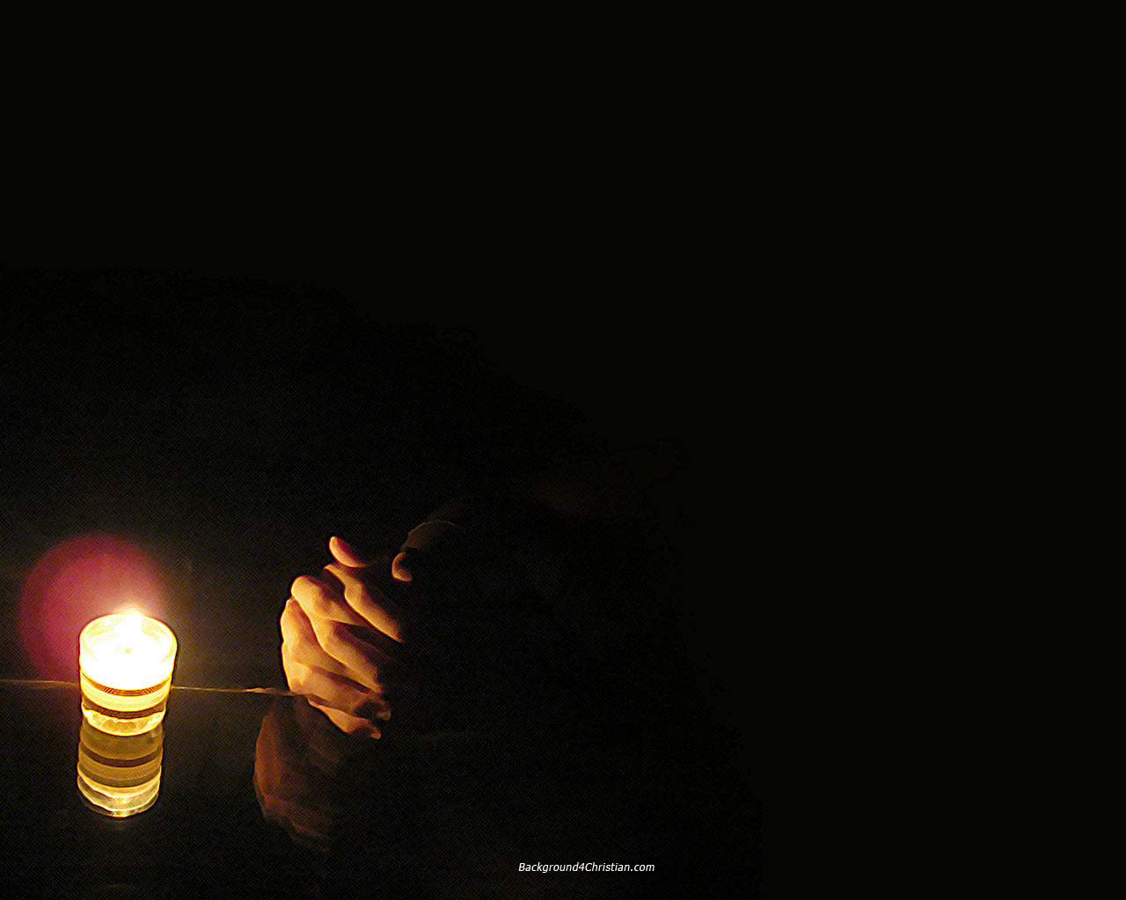
In the Secret Andy Park ccli 1810119
In the secret in the quiet place
In the stillness you are there
In the secret in the quiet hour
I wait only for you
'cause I want to know you more

Slide 3
I want to know you
I want to hear your voice
I want to know you more
I want to touch you
I want to see your face
I want to know you more

Slide 4
I am reaching for the highest goal
That I might receive the prize
Pressing onward,
pushing every hindrance aside
Out of my way
'cause I want to know you more

Slide 5
I want to know you
I want to hear your voice
I want to know you more
I want to touch you
I want to see your face
I want to know you more

Slide 6
In the secret in the quiet place
In the stillness you are there

