Slide 2
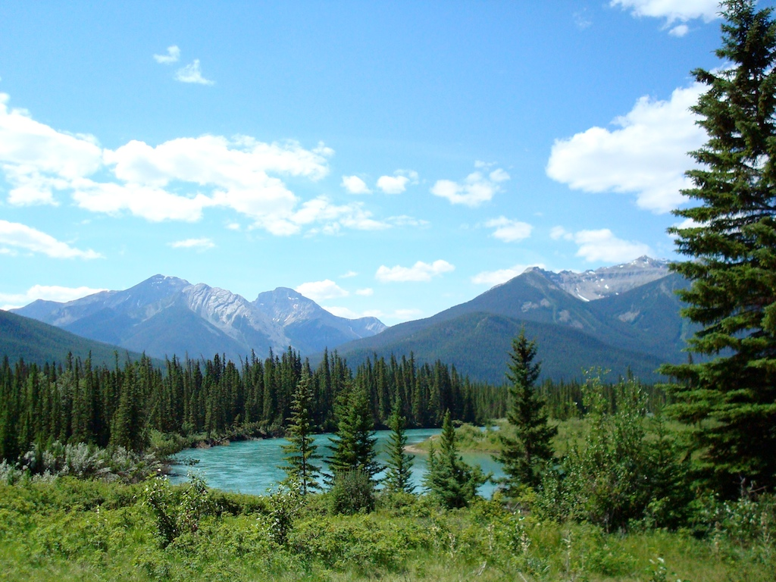
It is Well with My Soul Townend/Baggaley
Now when peace like a river
attendeth my soul
And when sorrows like sea billows roll
Then whatever my lot,
You have taught me to say
It is well, it is well with my soul

Slide 3
It is well with my soul,
When the storms of winter blow
And the cares of this world take their toll
In the heat of the day
there is grace enough to say
It is well, it is well with my soul

Slide 4
And when Satan should tempt me
And trial should come
Let this blessed assurance control
For He sees every weakness
And knows every fear
And has shed His own blood for my soul

Slide 5
It is well with my soul,
When the storms of winter blow
And the cares of this world take their toll
In the heat of the day
there is grace enough to say
It is well, it is well with my soul

Slide 6
It is well, it is well with my soul
It is well, it is well with my soul
(repeat)

