Slide 2
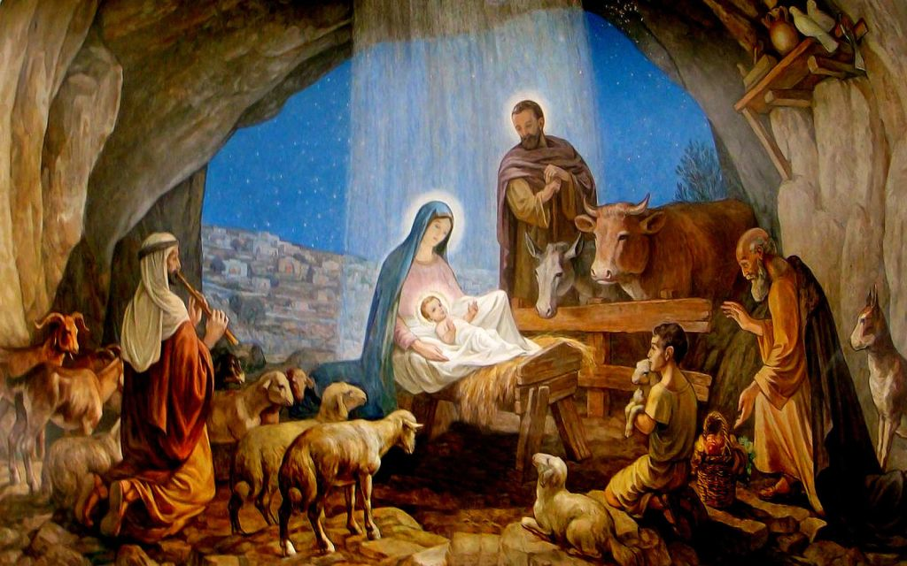
Joy to the world
The Lord has come
Let earth receive her King
Let every heart
Prepare Him room
And heav’n and nature sing
And heav’n and nature sing
And heav’n and heav’n and nature sing

Slide 3
Joy to the earth
The Saviour reigns
Let men their songs employ
While fields and floods
Rocks, hills, and plains
Repeat the sounding joy
Repeat the sounding joy
Repeat, repeat the sounding joy

Slide 4
He rules the world
With truth and grace
And makes the nations prove
The glories of
His righteousness
And wonders of His love
And wonders of His love
And wonders, wonders of His love!

