Slide 1


Slide 2
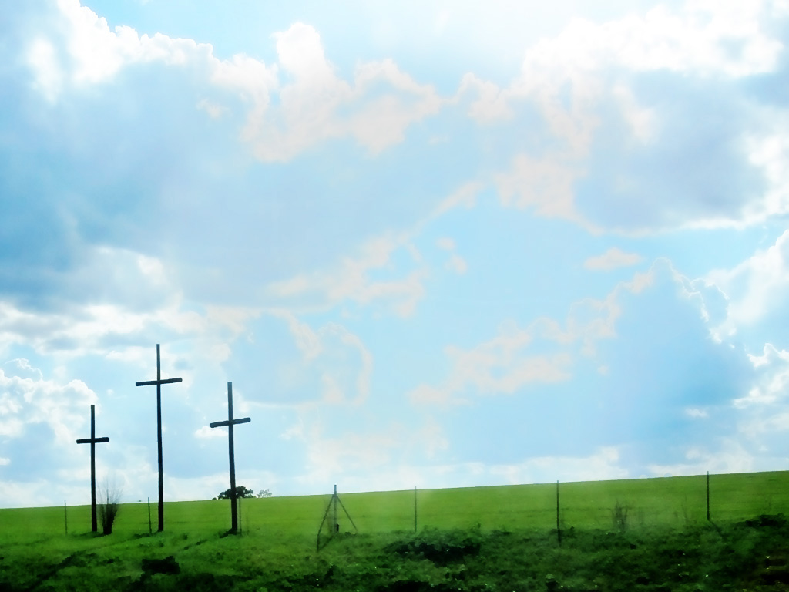
KNOWING YOU Graham Kendrick ccli 117947
All I once held dear, built my life upon,
All this world reveres and wars to own;
All I once thought gain
I have counted loss,
Spent and worthless now
compared to this

Slide 3
Knowing You, Jesus, knowing You
There is no greater thing.
You're my all. You're the best,
You're my joy, my righteousness,
And I love You Lord.

Slide 4
Now my heart's desire
is to know You more,
To be found in You and known as Yours,
To possess by faith what I could not earn
All surpassing gift of righteousness

Slide 5
Knowing You, Jesus, knowing You
There is no greater thing.
You're my all. You're the best,
You're my joy, my righteousness,
And I love You Lord.

Slide 6
Oh to know the power of Your risen life,
And to know You in Your sufferings;
To become like You
in Your death, my Lord,
So with You to live and never die

Slide 7
Knowing You, Jesus, knowing You
There is no greater thing.
You're my all. You're the best,
You're my joy, my righteousness,
And I love You Lord.

