Slide 2
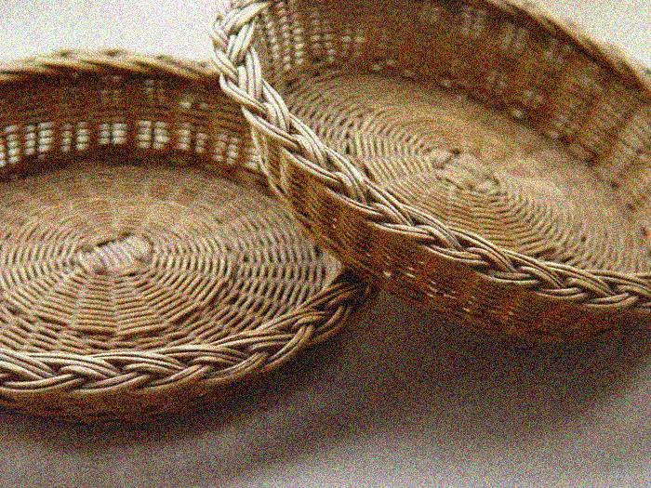
OFFERING Paul Baloche ccli 3956562
The sun cannot compare
To the glory of Your love
There is no shadow in Your presence
No mortal man would dare
To stand before Your throne
Before the Holy One of heaven
It's only by Your blood
And it's only through Your mercy
Lord I come

Slide 3
I bring an offering
Of worship to my King
No one on earth deserves
The praises that I sing
Jesus may You receive
The honor that You're due
O Lord I bring an offering to You

