Slide 1


Slide 2
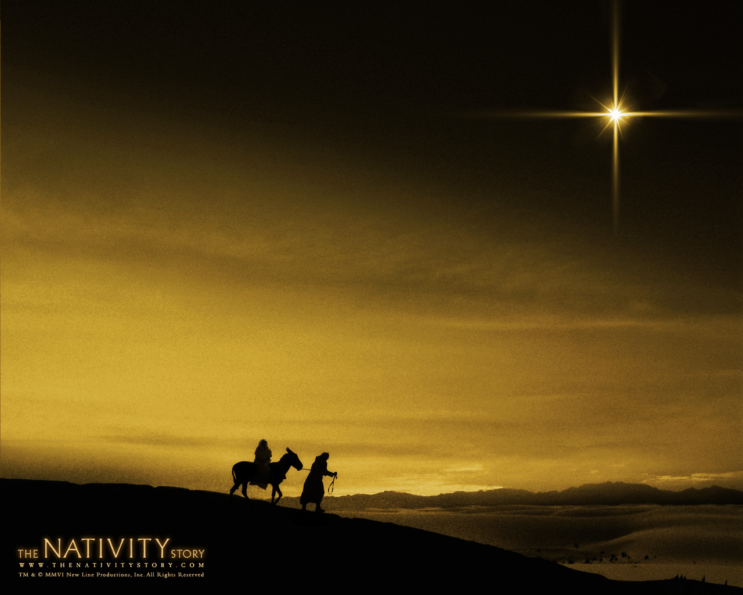
O come, all ye faithful
Joyful and triumphant
O come ye, O come ye to Bethlehem
Come and behold Him
Born the King of angels!

Slide 3
O come, let us adore Him
O come, let us adore Him
O come, let us adore Him
Christ the Lord

Slide 4
O sing choirs of angels
Sing in exultation
O sing, all ye bright hosts
Of Heav’n above
Glory to God. Glory in the highest

Slide 5
O come, let us adore Him
O come, let us adore Him
O come, let us adore Him
Christ the Lord

Slide 6
All hail Lord, we greet Thee
Born this happy morning
Jesus, for evermore
Be Thy name adored
Word of the Father
Now in flesh appearing

Slide 7
O come, let us adore Him
O come, let us adore Him
O come, let us adore Him
Christ the Lord

