Slide 1
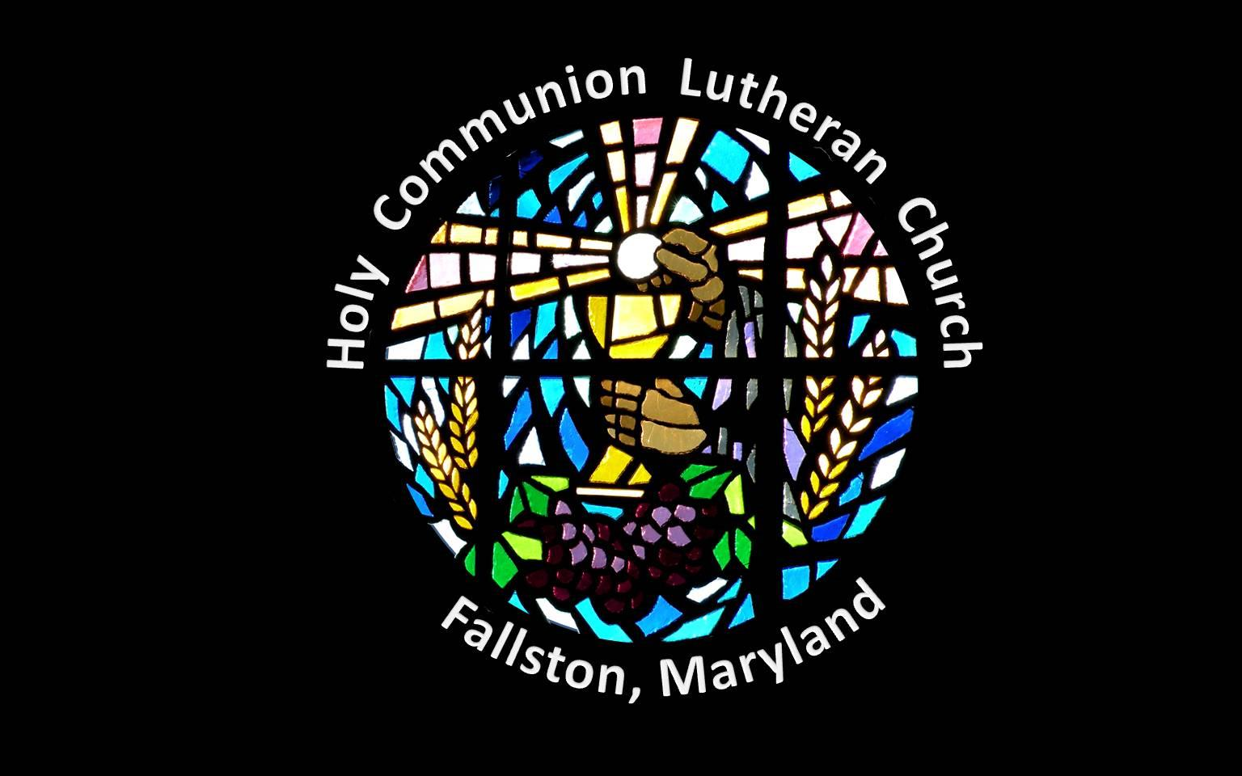

Slide 2
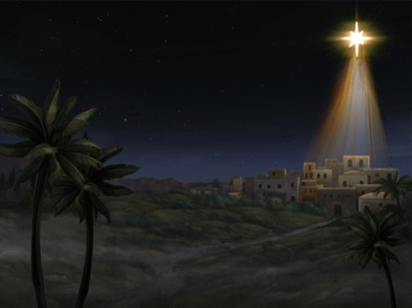
O little town of Bethlehem
How still we see thee lie
Above thy deep and dreamless sleep
The silent stars go by
Yet in thy dark streets shineth
The everlasting Light
The hopes and fears of all the years
Are met in thee tonight

Slide 3
For Christ is born of Mary
And gathered all above
While mortals sleep
The angels keep their watch
Of wondering love
O morning stars together
Proclaim the holy birth
And praises sing to God the King
And peace to men on earth

Slide 4
O holy Child of Bethlehem
Descend to us we pray
Cast out our sin and enter in
Be born in us today
We hear the Christmas angels
The great glad tidings tell
O come to us abide with us
Our Lord Emmanuel

