Slide 1


Slide 2
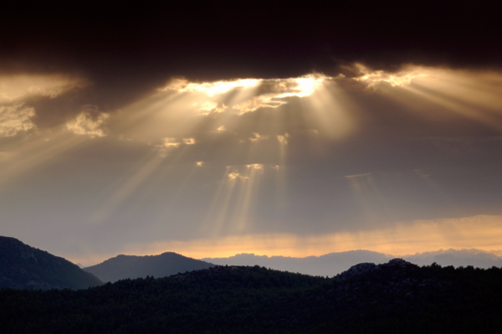
Praise Adonai
Paul Baloche ccli 2621742
Who is like Him, The Lion and the Lamb
Seated on the throne, Mountains bow down
Every ocean roars, to the Lord of Hosts

Slide 3
Praise Adonai, from the rising of the sun
Til the end of every day, Praise Adonai
All the nations of the earth
All the angels and the saints sing praise

Slide 4
Who is like Him, The Lion and the Lamb
Seated on the throne, Mountains bow down
Every ocean roars, to the Lord of Hosts

Slide 5
Praise Adonai, from the rising of the sun
Til the end of every day, Praise Adonai
All the nations of the earth
All the angels and the saints sing praise

