Slide 2
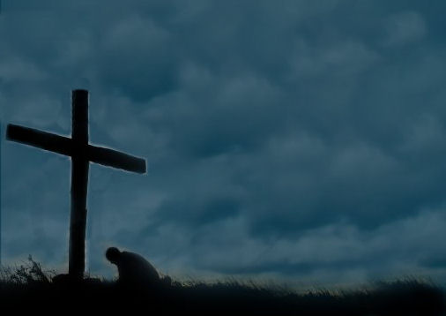
“REVELATION SONG”
Worthy is the Lamb
who was slain
Holy, holy is He
Sing a new song
to Him who sits on
Heaven’s mercy seat

Slide 3
Holy, holy, holy
Is the Lord God Almighty
Who was and is, and is to come
With all creation I sing,
Praise to the King of kings
You are my ev’rything
and I will adore you.

Slide 4
Clothed in rainbows of living color
Flashes of lightning, rolls of thunder
Blessing and honor strength and,
glory and power be
To you the only wise King.

Slide 5
Holy, holy, holy
Is the Lord God Almighty
Who was and is, and is to come
With all creation I sing,
Praise to the King of kings
You are my ev’rything
and I will adore you.

Slide 6
Filled with wonder awestruck wonder
At the mention of Your name
Jesus Your name is power,
breath and living water
Such a marv’lous mystery

Slide 7
Holy, holy, holy
Is the Lord God Almighty
Who was and is, and is to come
With all creation I sing,
Praise to the King of kings
You are my ev’rything
and I will adore you.

