Slide 2
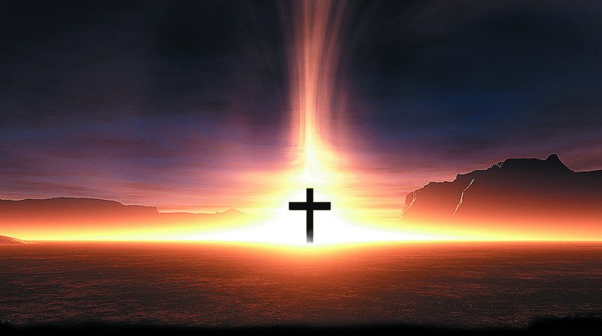
SANCTUARY
Thompson & Scruggs
Lord prepare me, With thanksgiving
To be a sanctuary I'll be a living
Pure and holy, Sanctuary
Tried and true for You

