Slide 1


Slide 2
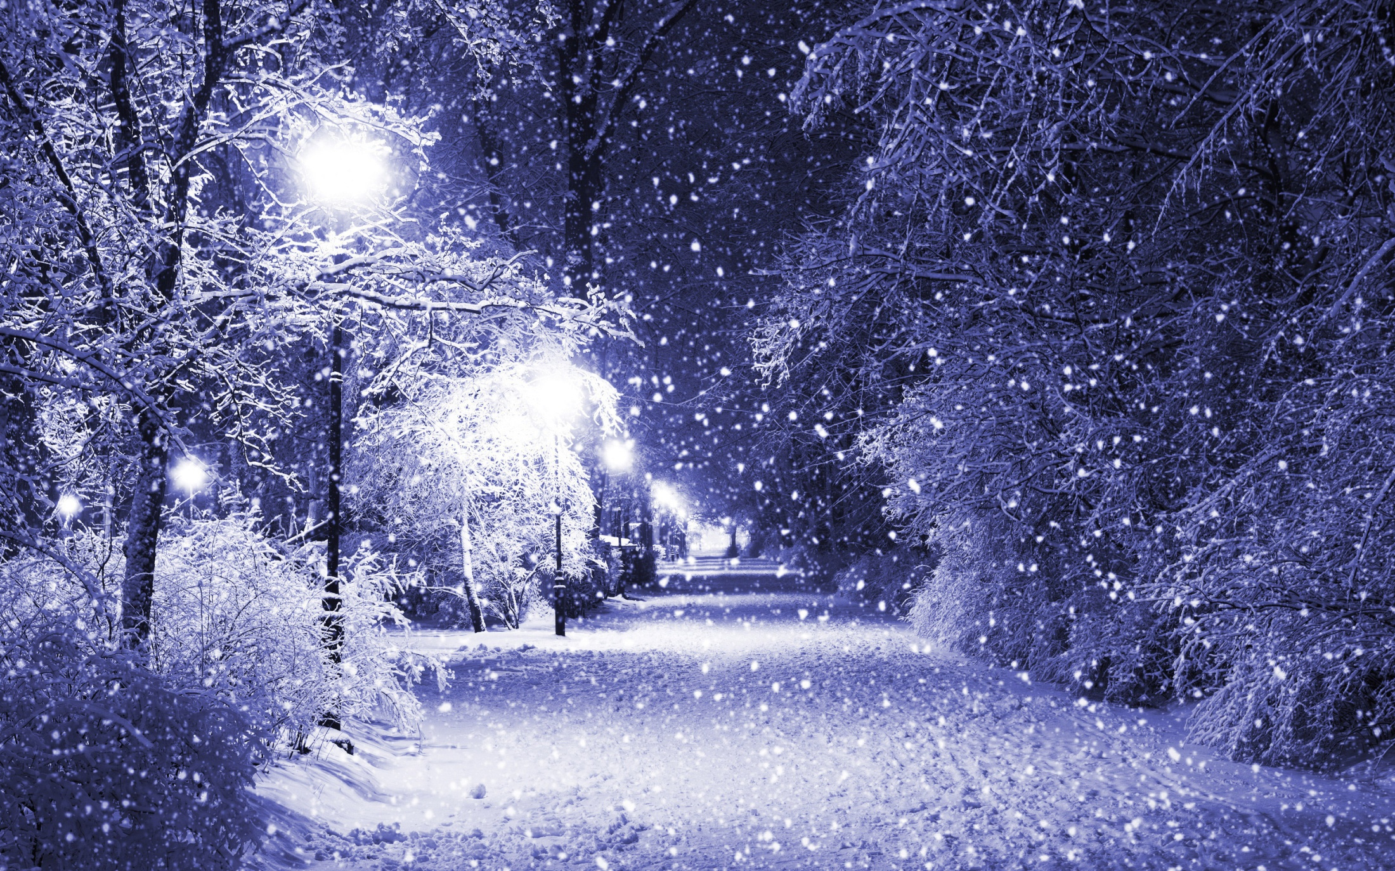
Silent night Holy night
All is calm All is bright
Round yon virgin mother and child
Holy infant so tender and mild
Sleep in heavenly peace
Sleep in heavenly peace

Slide 3
Silent night Holy night
Shepherds quake at the sight
Glories stream from heaven afar
Heavenly hosts sing alleluia
Christ, the Saviour, is born
Christ, the Saviour, is born

Slide 4
Silent night Holy night
Son of God, love’s pure light
Radiant beams from Thy holy face
With the dawn of redeeming grace
Jesus, Lord, at Thy birth
Jesus, Lord, at Thy birth

