Slide 1


Slide 2
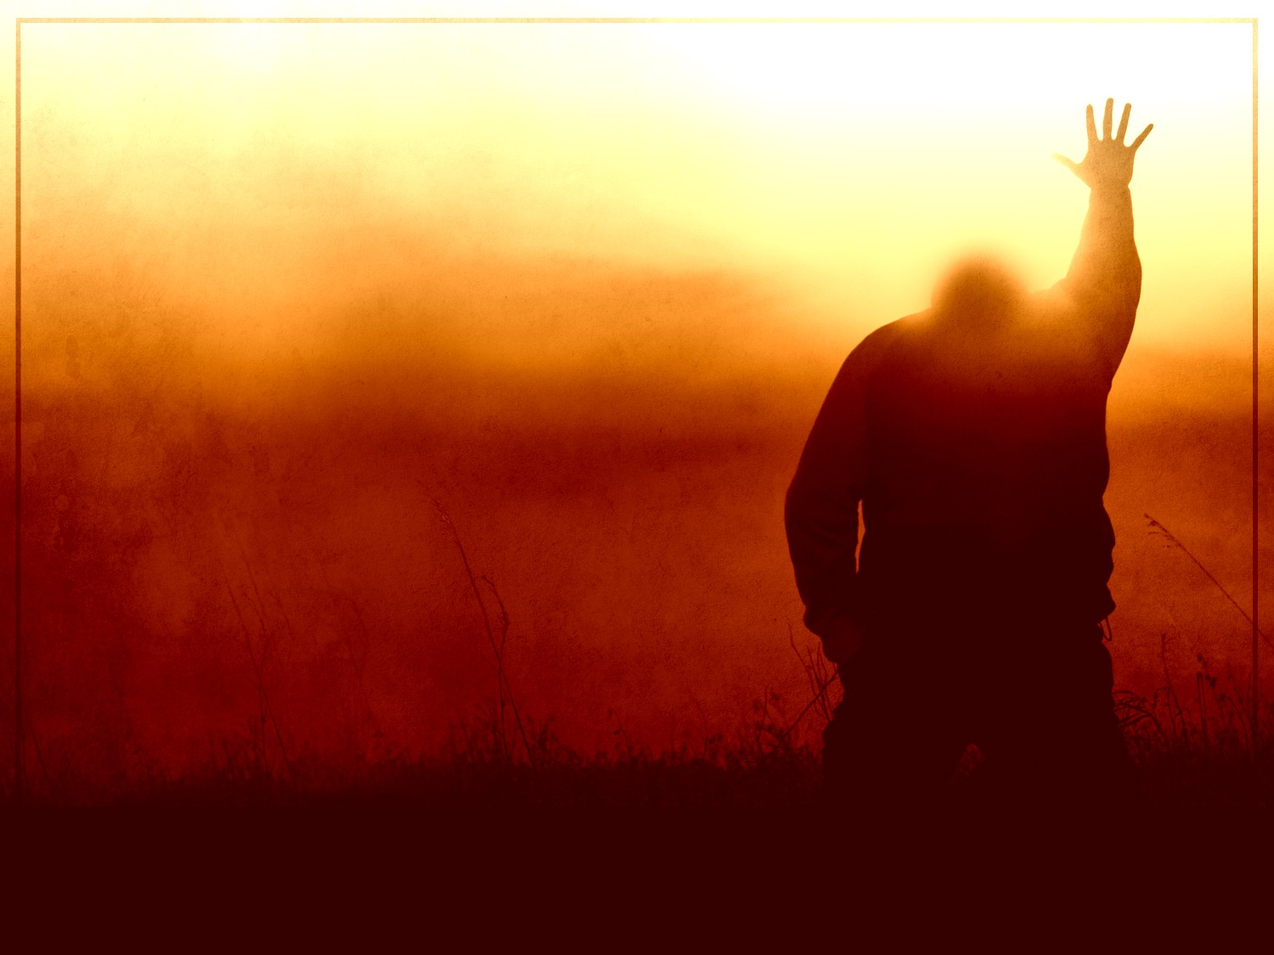
Take to the World
Go in peace to love and to serve
Let your ears ring long
with what you’ve heard
And may the bread on your tongue
Leave a trail of crumbs
To lead the hungry back
to the place that you are from

Slide 3
Take to the world this love, hope and faith
Take to the world this rare, relentless grace
And like the three in one
Know you must become
what you want to save
‘cause that’s still the way
He takes to the world

Slide 4
Go, and go far
Take light deep in the dark
Believe what’s true,
He uses all, even you
And may the bread on your tongue,
Leave a trail of crumbs
To lead the hungry back
to the place that you are from

Slide 5
Take to the world this love, hope and faith
Take to the world this rare, relentless grace
And like the three in one
Know you must become
what you want to save
‘cause that’s still the way
He takes to the world

