Slide 1


Slide 2
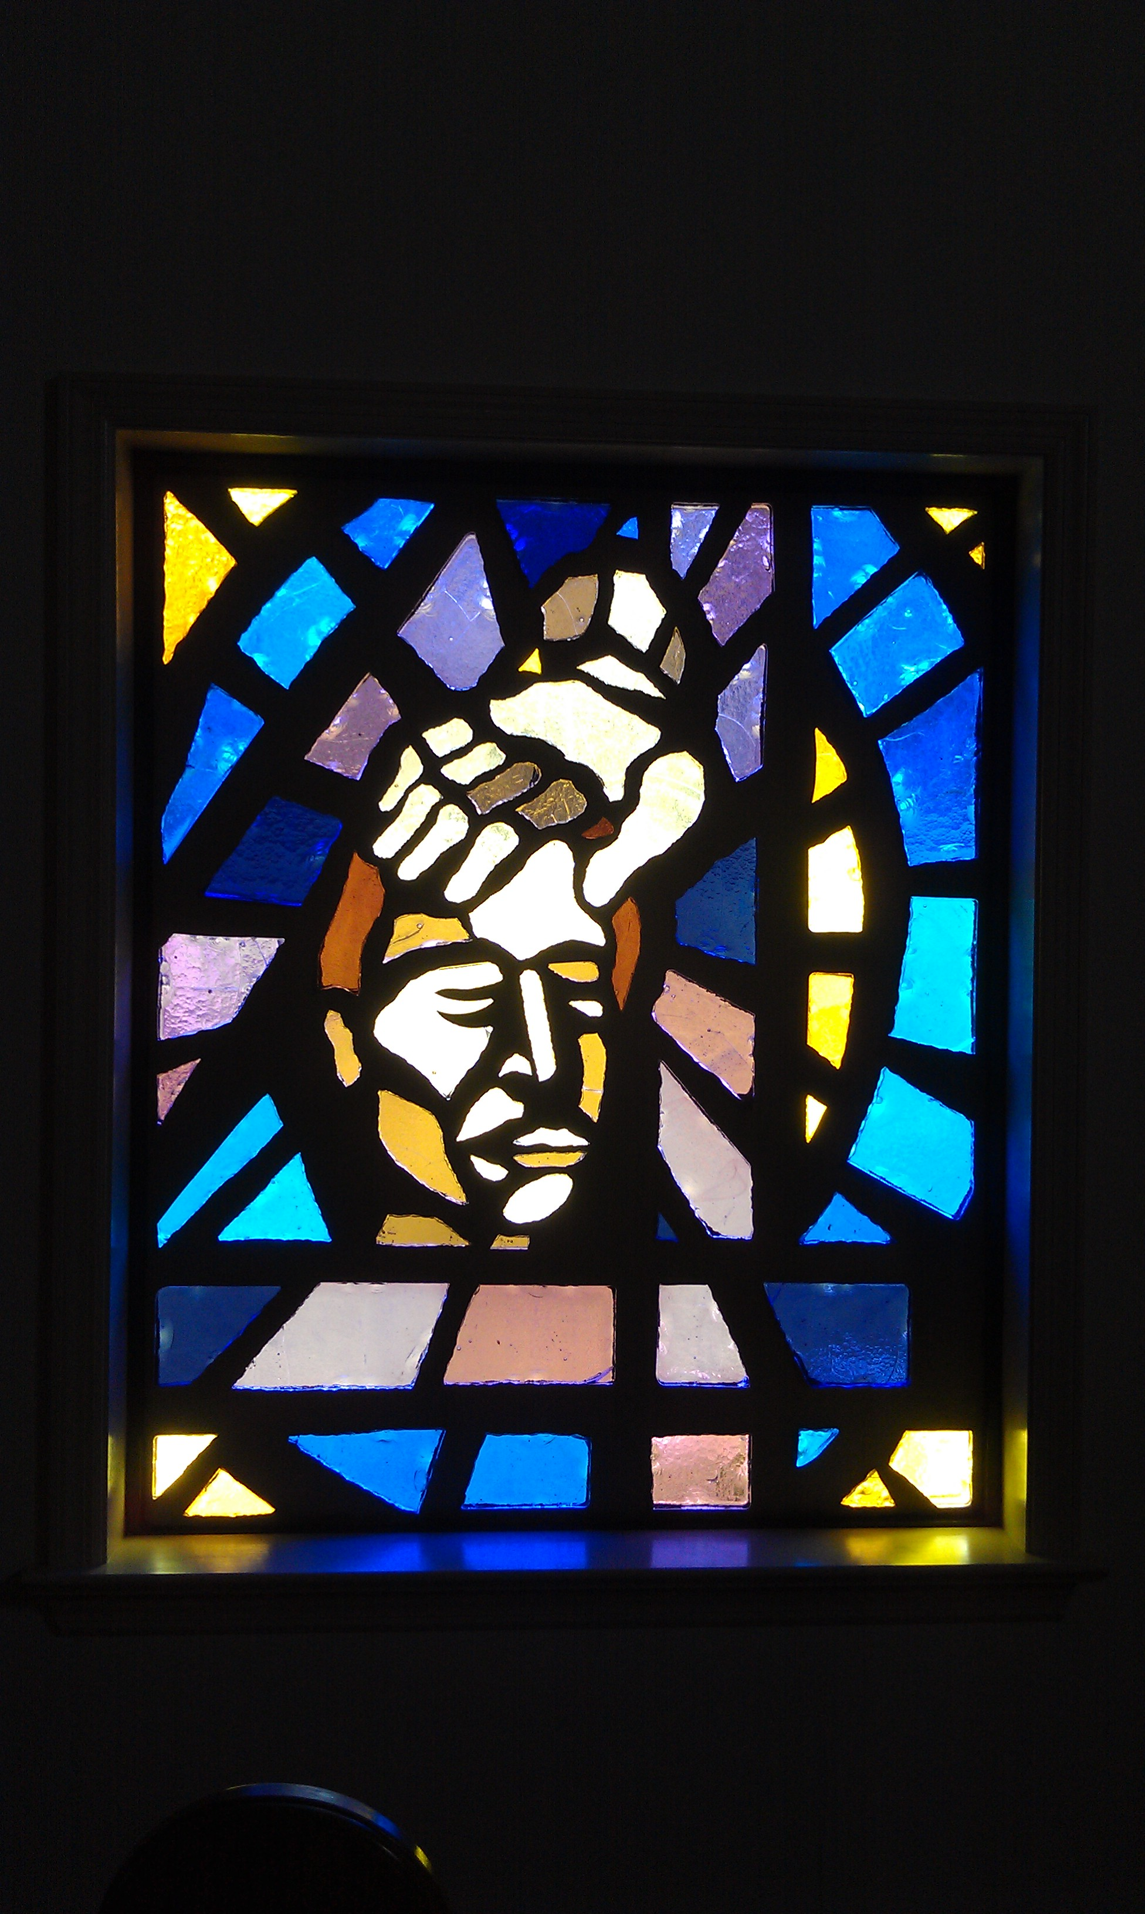
THE HEART OF WORSHIP Matt Redman ccli 2296522
When the music fades
All is stripped away
And I simply come.
Longing just to bring
Something that's of worth
That will bless Your heart.

Slide 3
I'll bring You more than a song,
For a song in itself
is not what You have required.
You search much deeper within
Through the way things appear.
You're looking into my heart.

Slide 4
I'm coming back to the heart of worship,
And it's all about You,
It's all about You, Jesus.
I'm sorry Lord, for the thing I've made it,
When it's all about You,
It's all about You, Jesus.

Slide 5
King of endless worth,
No one could express
How much You deserve.
Though I'm weak and poor,
All I have is Yours,
Every single breath.

Slide 6
I'll bring You more than a song,
For a song in itself
is not what You have required.
You search much deeper within
Through the way things appear.
You're looking into my heart.

Slide 7
I'm coming back to the heart of worship,
And it's all about You,
It's all about You, Jesus.
I'm sorry Lord, for the thing I've made it,
When it's all about You,
It's all about You, Jesus.

