Slide 2
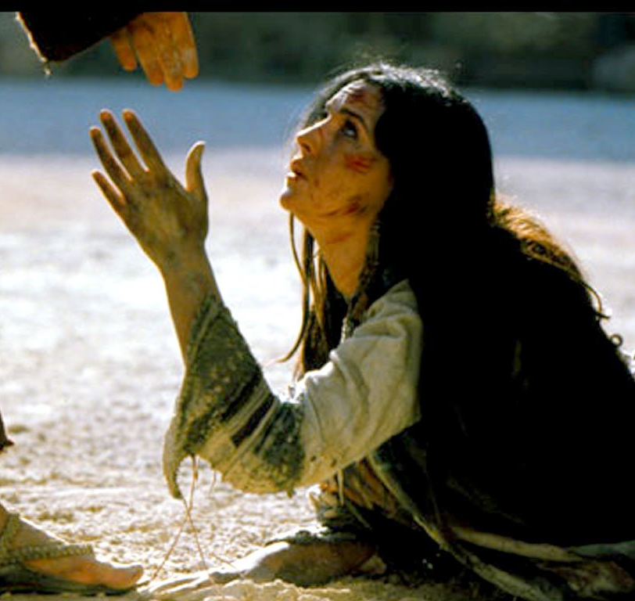
WE FALL DOWN Chris Tomlin
We fall down, we lay our crowns
At the feet of Jesus;
The greatness of His mercy and love,
At the feet of Jesus.
And we cry holy, holy, holy,
And we cry holy, holy, holy,
And we cry holy, holy, holy is the Lamb.

